Slide 1

Commissioners Vision
Pre-Retreat Strategic Planning
3 Year and 5 Year Plan

Slide 2
Welcome
Welcome
Mayor Keith W. Babb, Jr
Invocation & Pledge of Allegiance
Vice-Mayor Clara Murvin

Slide 3
Introductions
Elected - Officials
Mayor Keith W. Babb, Jr
Vice-Mayor Clara Murvin
Commissioner Derrick Boldin
Commissioner Juan Gonzalez
Commissioner Sara Perez

Slide 4
Introductions
Staff
Rodney Lucas, City Manager
Jongelene Adams, Deputy City Manager
Tijauna Warner, City Clerk
Joseph Martin, Interim Director Finance
Carlos Mangual, Operations Manager
Alvin Johnson, Director Public Works
Greg Williams, Director Parks and Recreation
Pegy Boule-Washington, Director Community & Economic Development

Slide 5
Purpose
We are gathered to capture the vision of the City Commissioners vision for the City of Pahokee for the next 3 and 5 Years.
The Commissioners will discuss and develop a strategic plan at this pre-retreat to be presented at a future Town Hall to the community.

Slide 6
Commissioner’s 3-Year Plan
What is the Commission’s vision for the community in the areas of:
Attainable & Affordable Housing
Sustainable Infrastructure
Economic Development
Financial Stability
Environmental Viability

Slide 7
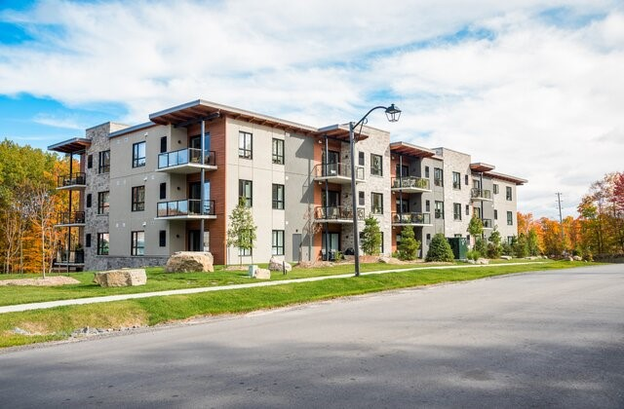
Forecast 3-Year Plan
Attainable & Affordable Housing

Slide 8

Forecast 3-Year Plan
Sustainable Infrastructure

Slide 9

Forecast 3-Year Plan
Economic Development

Slide 10

Forecast 3-Year Plan
Financial Stability

Slide 11

Forecast 3-Year Plan
Environmental Viability

Slide 12
Forecast 5-Year Plan
What are the commissioners vision for the community for the following:
Attainable & Affordable Housing
Sustainable Infrastructure
Economic Development
Financial Stability
Environmental Viability

Slide 13
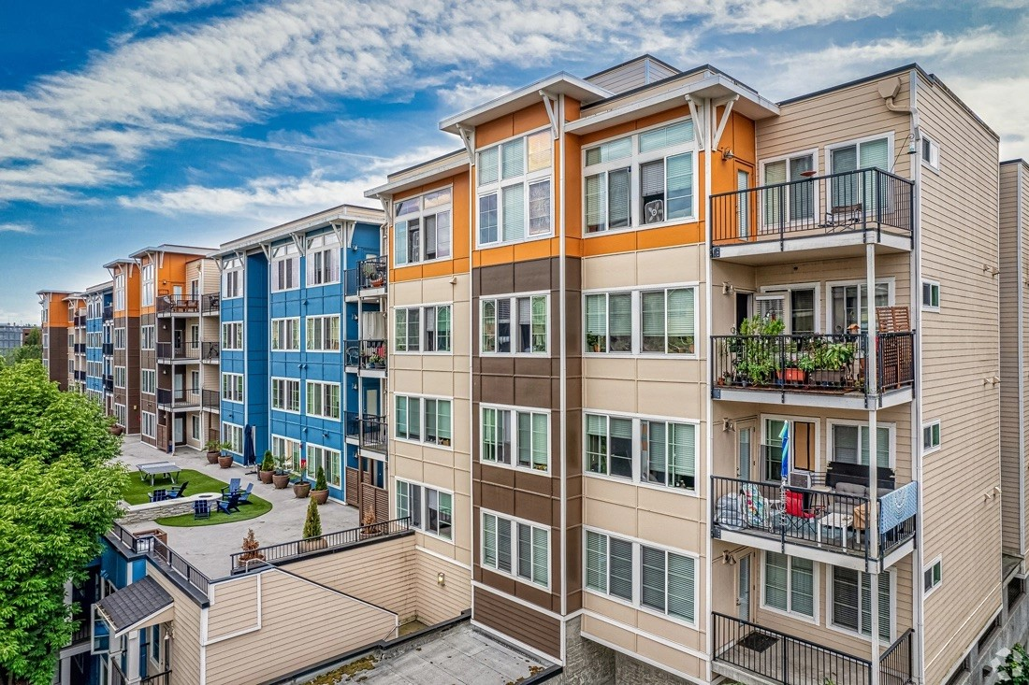
Forecast 5-Year Plan
Attainable & Affordable Housing

Slide 14
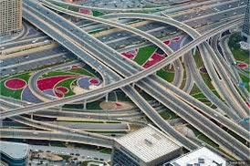
Forecast 5-Year Plan
Sustainable Infrastructure

Slide 15

Forecast 5-Year Plan
Economic Development

Slide 16

Forecast 5-Year Plan
Fiscally Sound

Slide 17

Forecast 5-Year Plan
Environmental Viability

Slide 18


City Alignment
How will our goals/vision align with the mission for the City

Slide 19
Previous Tabled Vision
Looking back to last year retreat:

Slide 20
Organizational Chart
City of Pahokee
Organizational
Chart

Slide 21
GOAL SETTING
Strategic Goals:
Foster sustainable growth and development
Ensure our quality of life
Lead with environmental stewardship
Improve our infrastructure
Embrace financial accountability and transparency

Slide 22
RANK ITEMS OF IMPORTANCE
Items to be prioritize for the remaining FY2020-2021 Budget
Public Services Building and storage building in back (keep records)
26 Acres and 9 Acres
Paint current City Hall and service A/C
Redevelopment of New City Hall/Old Pahokee High School
City of Pahokee Campground & Marina - repairs
Port Mayaca Cemetery – Office Roof and lawn equipment
American Rescue Plan Act
Amend Ordinances
  COMP Plan
  Planning and Zoning
  Code Enforcement
  Economic Incentive
  Update Personnel Handbook
  Utility Master Plan
Housing
  New development and redevelopment
  Multi-family (Duplex and Triplex)
  Townhomes
Economic Development
  Commercial
  Industrial
  Tourism grant
  Downtown Redevelopment
Infrastructure
  Roads/Streets and sidewalks
  Storm Water Drainage
Fleet/Lease – vehicles/mobile generators/equipment
Events:
  Back to School Bash – August 7
  Art in the Park – September
  Storm of 1928 Remembrance – September
  Centennial (100 years) celebration – Select committee
Updated projections
  IT/software
  Personnel – 8 additional
  Parks & Recreation Complex/EVP Cafeteria A/C
  MLK Park renovation
  Commissioner’s Park – Splash Pad
Notes:
w

Slide 23
RANK ITEMS OF IMPORTANCE CONT’D
Notes:
w

Slide 24
VISION AND VALUES
Vision and Values:
“Respecting the Past, Focused on the Future”
Mission and Vision Statements
Notes:
w

Slide 25
PURPOSE
The City of Pahokee provides, protects, nurtures and cares for its community of residents, businesses, visitors and supporters. We create and sustain the best quality of life for the people that are the fabric of our entire community. Within that, we are the Heart of the Okeechobee Lake Community, and utilize that presence to foster the improvement of our entire city and all of its residents.
Notes:
w

Slide 26
OUR MISSION
Inspiring a vibrant community.
The City of Pahokee is a premier destination, both to visit and to live. Our community is rooted in a rich history, committed to time honored values and dedicated to an evolving, promising and sustainable future. We embrace tradition and diversity equally, to maintain and truly unique environment and character. We celebrate our role as the agriculture heartbeat of the Sugar cane, cabbage, corn and citrus economy, culture, geography, and are passionate about fostering a diverse, innovative and culturally, vibrant population. We are the primary destination in the Florida agriculture and marina businesses and the central hub for the industry as a whole within the state.
Notes:
w

Slide 27
COMMISSIONERS MISSION
The City Commission of the City of Pahokee is dedicated to providing its citizens, businesses and visitors with quality services that ensure a city lifestyle to want to work, live and play in Pahokee.
Notes:
w

Slide 28
OUR VISION
The City of Pahokee strives to maintain a uniquely desirable and sustainable community.
We are unique because of our people, our grand natural resources, public amenities, leadership, diversity, and home town atmosphere.
We will continue to conserve, preserve and manage our precious resources, including Lake Okeechobee and its unique riparian habitat.
Notes:
w

Slide 29
OUR CORE VALUES
Honor everyone. Demonstrate respect for all persons.
Loyalty to the team, vision, mission and objectives.
Inclusion
Diversity
Transparency
Stewardship. Be good stewards of agency funds.
Empathy. Care about people.
Understanding
Non-Judgmental
Respect individual strengths; Embrace diversity.
Professionalism always. Maintain a positive attitude & a pleasing personality.
Teamwork. Cultivate a “we environment.” – Be passionate team player.
Notes:
w

Slide 30
Next Steps
Schedule Town Hall or Work Shop meeting to get the public’s opinion

Slide 31
Questions?
Comments
Recommendations

